Slide 1


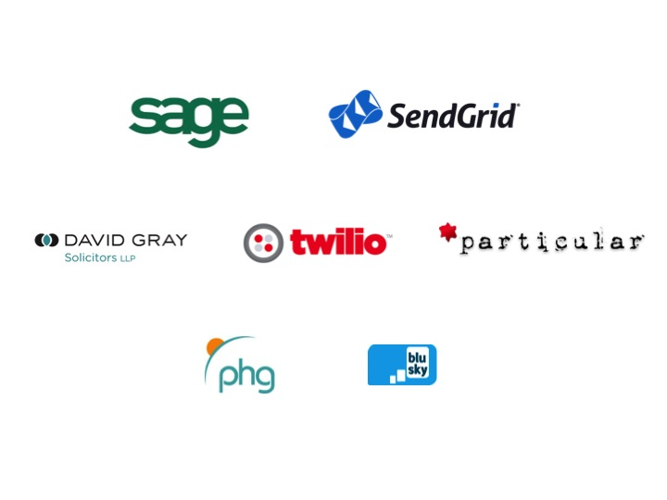

Slide 2
What is Kivy?
Kivy - “Open source Python library for rapid development of applications that make use of innovative user interfaces, such as multi-touch apps.”
Cross platform - Linux, Windows, OS X, Android and iOS.
Kivy is 100% free to use, under an MIT license
Part of a group of modules to build apps
(Plyrs, PyJnius, python-for-android, etc)

Slide 3
Batteries included?
Basic set of UI controls like buttons etc
Layout system for organising on screen controls
A domain specific language call KV for defining controls/widgets more simpler
A Screen Manager to control what part of your app is currently on screen

Slide 4

Death by DEMO!

Slide 5
Installing Kivy
Download the installer from http://kivy.org/#download (I used the ubuntu PPA)
Install Cython using pip
    sudo pip install cython
Install buildoser
    git clone https://github.com/kivy/buildozer.git
    cd buildozer
    sudo python setup.py install

Slide 6

Basic App Demo!

Slide 7
Building your app
Put all your main app code into a main.py file
Create a buildoser spec:
  buildoser init
Configure your spec file for the platform
Run the build command
  buildoser android debug deploy run

Slide 8

War story

Slide 9
Pros:
  cross-platform,
  good start for developing apps for mobile,
  UI components are solid, (except for ListView!).
  Nice set of modules for feeds
  Fairly easy to learn layout logic
Cons:
  you can only build android on Linux,
  you can only build iOS on a Mac.
  You can only compile Window version within windows.
  ListView isnt a good enough solution so you may have to build your own.

